Slide 1


Online Enrollment Demo
www.my401kdata.com
Notes:
Welcome to TPC 401(k)! And congratulations on becoming eligible to participate in your company retirement plan. Your participation in this plan will be one of the most important decisions of your lifetime. Its a proven fact that a successful retirement account ensures a successful retirement lifestyle.
Whether you’ve already participated in a 401(k) with a previous employer, or maybe you’re brand new to the concept -we will help you with anything you might need every step of the way.
This short presentation will walk you through the simple steps of enrolling online. I will also point out a few features and resources available to you as a participant in this account for future reference. You will have the ability to pause or go back should you need to during this presentation at any time. I will also provide our direct contact information at the end in case you have any questions.
To start, you will want to go to our website. WWW.my401kdata.com.

Slide 2

Getting Started
Notes:
So let’s get started. You can listen to these steps at your own pace- and as mentioned previously, you have the ability to pause or rewind at any time.
The first step is getting to our website…which looks like this. Make sure you’re at the correct web address..which is www.my401kdata.com. You might want to bookmark this page so it will be a bit easier to get to in the future.
You’ll notice that there are different portals for Participants, Plan Sponsors, Financial Advisors, and there are also 401(k) calculators which we will talk about later. But for now, you’re going to want to click on Plan Participants.

Slide 3

Getting Started
Notes:
After clicking on “Plan Participants” you will be taken to the page you see here. You will notice a side menu bar in dark green. AS you can see, you will have the option to login to your account, and you will also have the option to check out the latest news and resources available. Youll also find some of our general forms, Frequently asked questions, and 401(k) calculators, which you can use to help you decide how much you need to save, whether to consider roth or pre tax contributions, and so on. We hope you will take advantave of all of these resources as we have created them specifically for you the participant to help you achieve your goals.
When you’re ready to login to begin the enrollment process, simply click on “Partiicpant Login” from the menu.

Slide 4

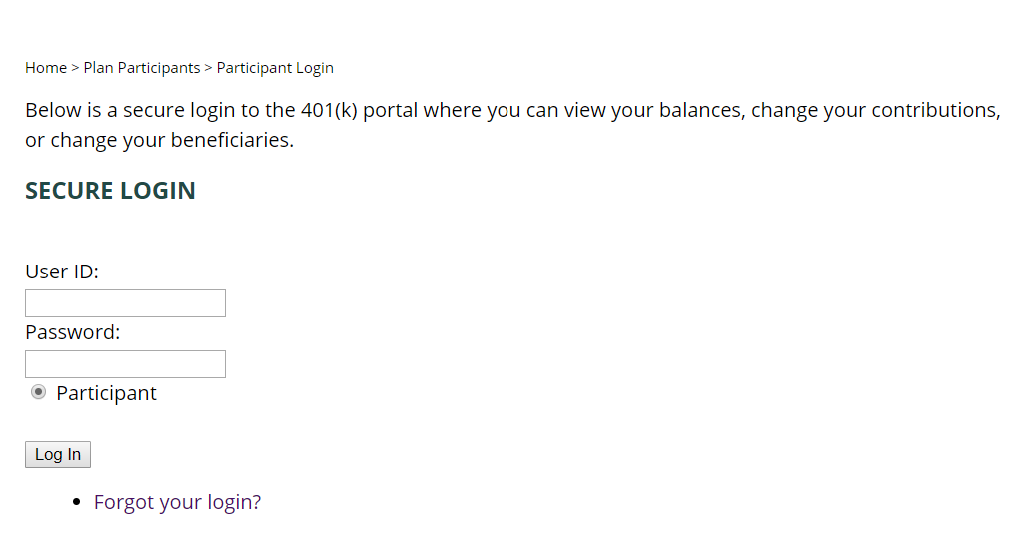
Logging in for the first time.
Your User ID will be the 9 numbers of your social security number
Your password will be the last 4 numbers of your social security number
Click on the “login” button
No spaces or dashes
This will be the only time you need to use your social security number
IF you have any trouble with this, call us at 1.888.505.4484
Notes:
After clicking on “Participant Login”from the menu, you will see the screen shown here. If it’s your first time logging in, you will use the 9 numbers of your social security number for the USER IDA and the last four numbers of your social security number for the password. After entering this information simply click on the “log in” button.
A few additional things to mention…Make sure you’re just entering the numbers…no spaces or dashes.
This will be the only time you will need to use your social security information, as it’s simply so the system can recognize who you are.
If after a few attempts you’re not able to login, please call us directly at 888.505.4484

Slide 5
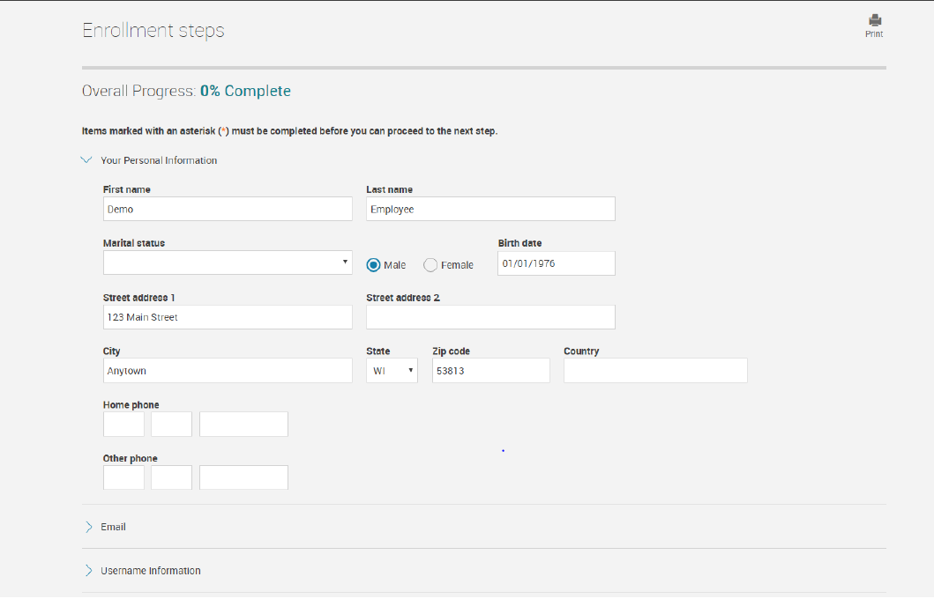
Enrollment Steps – General Info
Notes:
So the first screen you will see upon entering the enrollment process is the one you see here. You will notice throughout entire enrollment process that you can track your progress at the top of the screen. When you get to 100%, you know that the process is complete. Some of your information will be pre populated such as your name and address. Take a second to review that these are accurate. Next, you will want to enter in your phone number if there isn’t one already entered.

Slide 6

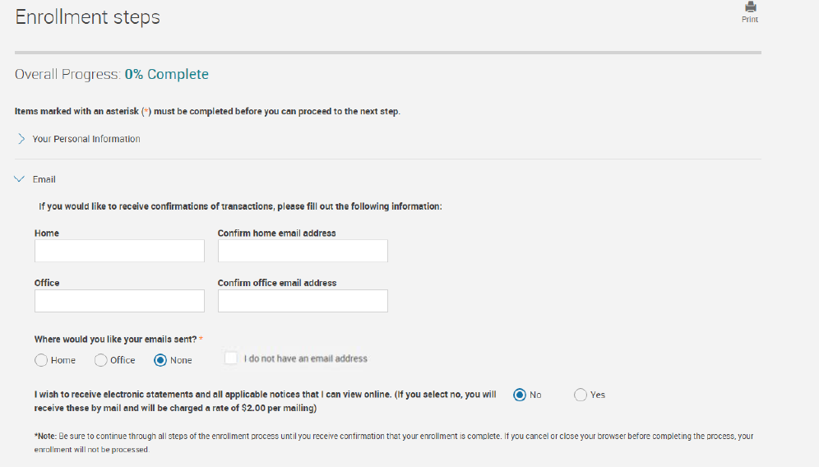
Enrollment Steps - Email address
and E-statement election
Notes:
The next step will be to enter e mail information. You will have the option to enter up to 2 e mail addresses, which can be updated or changed at any time. After entering this information, select which e mail you’d like us to send notifications to if applicable.
Next you will decide if you’d like to receive your statements electronically via e mail, or if you’d rather receive a paper copy.
If you do NOT have an e mail address or do not wish to use one, please check the box that says “I do not have an e mail address.” You do have the option to update this information at any time in the future.

Slide 7
Enrollment Steps – Create a User ID and Password
User ID must be both letters and numbers and at least 8 characters
Password must also be alphanumeric and at least 8 characters
No symbols, spaces, or dashes
Use this new ID and password the next time you login
Notes:
Next you will establish your user ID and password. Make sure that both are at least 8 characters in length, and are alpha numeric/that is…containing at least both one letter and number. Be sure not to use any symbols or dashes. Just letters and numbers. Be sure to write this down, as this will be what you will use to access your account online going forward.

Slide 8

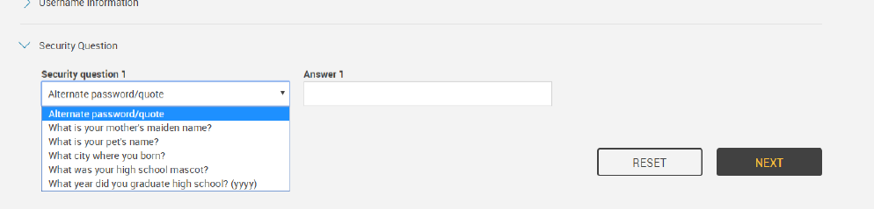
Enrollment Steps –
Establish a security question
Notes:
The last step on this enrollment screen is to establish your special security questions. These will be used to verify security in the event that you inquire on your account or need to reset your password for any reason. Be sure to select a question that only you know the answer to, and that you know you won’t forget.
After you have established this information, you will click on the “Next” button.

Slide 9
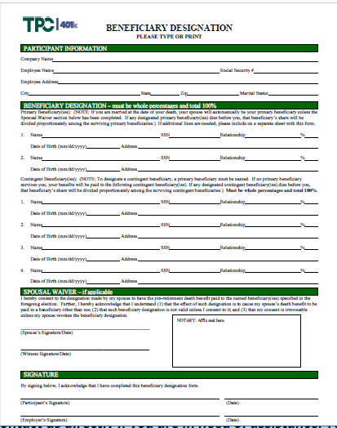
Enrollment Steps – Select Your Beneficiaries
1.888.505.4484
Notes:
Now as you will notice, you are about 33% through the process. Next you will want to input the information about your beneficiaries. You will notice that “primary” is the beneficiary type that populates for you. Whomever you list as primary beneficiary is going be first in line to inherit this account should something happen to you. You can designate as many primary beneficiaries as you would like by clicking the “add” button after entering the information. It’s important to point out, however that if you’re legally married and.if your spouse is not your only primary, he or she will need to sign a “spousal consent form” in order for this to be valid. This form was included in your enrollment kit, and can also be found on our website within that green menu of options and respources I showed you on the first slide. under “participant forms”
The second beneficiary type available is “contingent”. You can change the beneficiary type using the drop down menu here (animation….pause) Anyone listed as a contingent will receive the money at the percentage you elect should your primary beneficary pass away first. An example of a typical election would be to designate a spouse as primary beneficiary 100%, and children as equal contingents.
If you should have specific questions regarding these elections, please contact us. You can change or update this information at any time online or over the phone.
After all of your beneficiaries have been listed, click on the “Next” button.

Slide 10

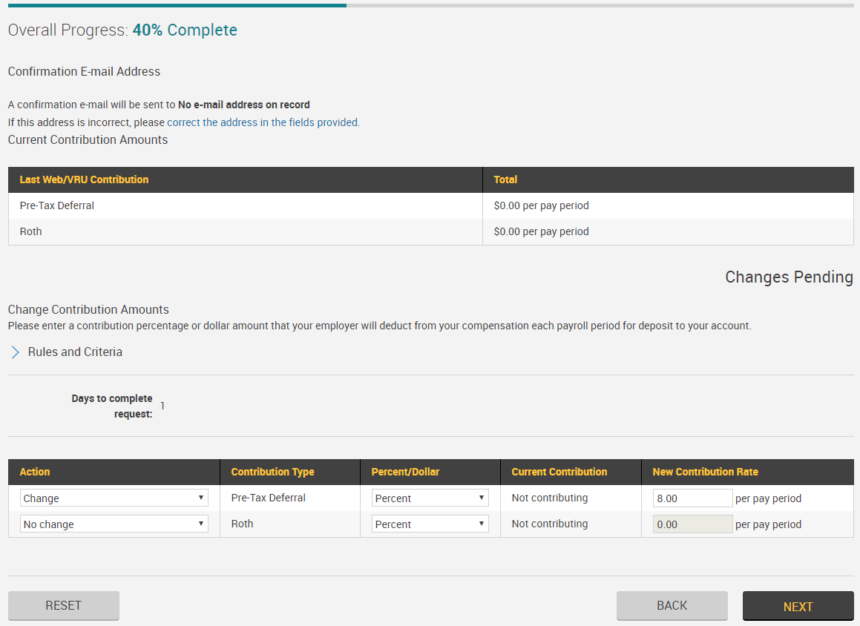
Enrollment Steps – Choose a Contribution Amount
Notes:
Now it’s time to enter the amount you’d like to contribute from each paycheck. These options could vary depending on your plan’s specific parameters. Most commonly, the deferral options are Pre-tax and Roth. You can elect one or the other, or if you’d like, you can decide to go with both types.
You can make your elections under the area designated as “Action”. First, use the drop down menu to update the action to “Change”. IF your plan allows, you will need to indicate if you want to contribute a % or a $ amount. Next, you will enter in the amount you’d like taken from each paycheck. As you can see here in this example, the ppt elected to contribute 8% on a pre-tax basis.
After you have made your elections, click the “Next” button.

Slide 11
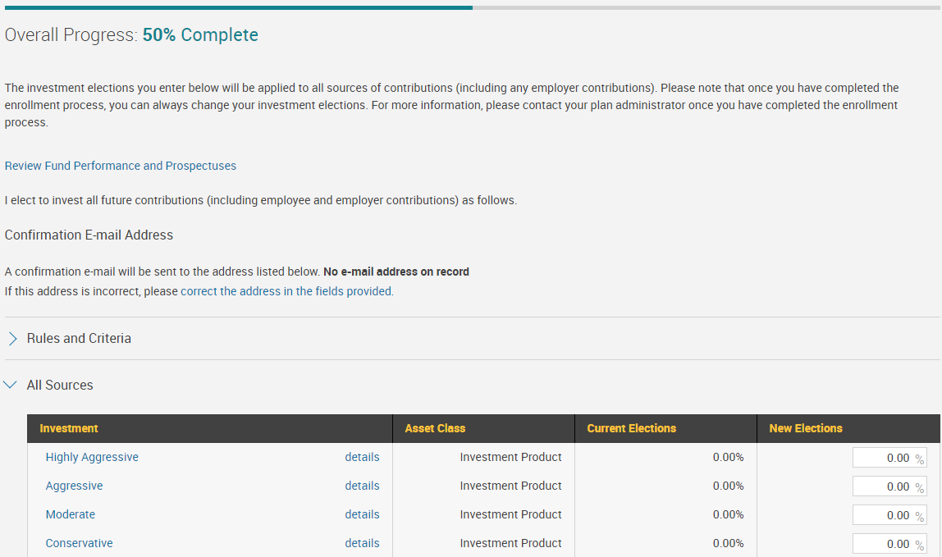
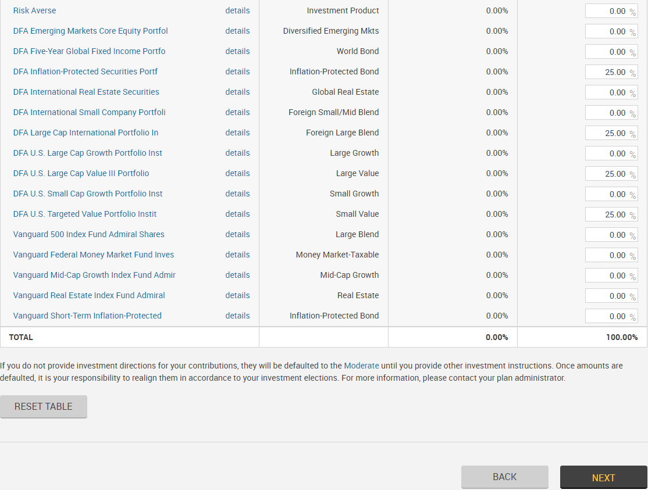

Enrollment Steps – Select Your Funds
Notes:
You are now officially half way finished! Now it’s time to elect the investments for your account. The investments you see here are just for example purposes, so you could see a different list depending on the options within your plan.
The information regarding these options should have been provided along with your enrollment materials. Regardless of the investments you select, you will just want to make sure that your total is 100%. AS you can see in this example, this participant elected 4 funds at 25% each totaling 100%.
Keep in mind that these investments can be changed at anytime here online or over the phone. If you don’t make an election, any money deposited will invest in the moderate portfolio as a default.
If you would like to discuss this section further in detail, please contact your plan financial advisor if applicable, or call one of our representatives at 1.888.505.4484.
After your total appears at 100%, click “next”.

Slide 12

Enrollment Steps – Review Your Info
Notes:
And now you’re at the final step of the enrollment process. Here you will find a compilation of all of the information you submitted. Take a moment to review each section for accuracy. If you should need to edit or make changes to any of the information listed, simply click on the “edit” button located on the right hand corner of each section and you will be taken directly to that area.
If you find the information to be accurate, click on the “Submit” button on the lower right hand corner of the screen.

Slide 13
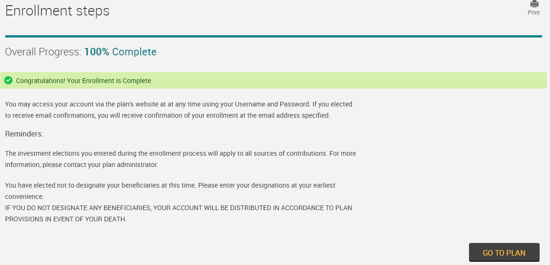
Enrollment Steps – COMPLETION!
Processing takes place at 2:00 cst every business day
Email confirmation will be sent at this time
Elections made after 2pm, confirmation sent at 2pm next business day
Notes:
Congratulations! Your enrollment is complete. When overall progress reaches 100%, you know that your enrollment was submitted successfully.
Please note – processing of this information on the website will take place at 2:00pm central time each business day. If you entered an e mail address, you will receive a confirmation of your enrollment elections at that time. Your information will not populate on the website until this time. If you made your elections AFTER 2pm, you will receive your confirmation at 2pm the following business day and your information and elections will also be visible at that time.

Slide 14
TPC 401(k) – CONTACT INFORMATION
Our DIRECT Phone number is 1.888.505.4484
  Rings direct to a person
E mail address: 401k@payrollcompany.biz
  Monitored daily
Be sure to utilize all of the resources on our participant portal! (financial calculators, FAQ’s, newsletters, etc)
Notes:
Here is our contact information if you’d like to reach out to discuss this process or if you should have questions at any time going forward. The 800 number is toll free and rings directly to a live person. And this e mail address you see here is monitored daily to ensure a prompt response.
We hope this information has been helpful. Please remember to make use of all of our participant resources on our website including retirement savings calculators, informative newsletters, and forms. We look forward to working with you in the future!

